Slide 1
Global Fishery Status Update
August 28, 2014
Tyler Clavelle, Dan Ovando, Cody Szuwalski

Slide 2
The Code

Slide 3
Data Sources
RAM Legacy
Rdata object received from Ray 7/23/14
436 stock assessments
FAO SOFIA dataset
2000-2009
566 “qualitative” stock assessments
FAO Capture Dataset
1950-2011
20,268 catch histories

Slide 4
Overlap Identification
Objective: Identify and remove FAO stocks that overlap with RAM stocks
Methodology:
FAO regions manually assigned to RAM stocks based on “areaname” RAM variable.
RAM stock assigned all possible FAO regions when a single FAO region cannot be identified (e.g., multiple regions surrounding country, multinational stocks)
Look for FAO stocks that match RAM stocks at the Country, Species, and FAO region levels

Slide 5
Overlap ID Results (raw data)

Slide 8
NEIs within FAO

Slide 9
NEI for Countries of Interest
Country | Total Catch 2011 (MT) | Fisheries | Percent NEI Catch
Austria | 350 | 3 | 100%
Myanmar | 3,277,102 | 3 | 100%
Palau | 926 | 19 | 100%
Viet Nam | 695,284 | 13 | 93%
China | 9,773,304 | 74 | 87%
Mexico | 551,084 | 127 | 60%
Denmark | 485,859 | 91 | 58%
Croatia | 6,404 | 43 | 58%
Italy | 85,667 | 100 | 51%
Latvia | 108,948 | 52 | 48%
Indonesia | 3,593,564 | 135 | 47%
Poland | 118,767 | 112 | 46%
Japan | 1,408,896 | 362 | 45%
Peru | 361,938 | 53 | 45%

Slide 10
NEI for Countries of Interest
Country | Total Catch 2011 (MT) | Fisheries | Percent NEI Catch
Lithuania | 72,331 | 68 | 45%
Nauru | 575 | 5 | 42%
Cyprus | 946 | 34 | 37%
Greece | 49,724 | 103 | 32%
Sweden | 119,924 | 73 | 27%
Spain | 832,408 | 464 | 24%
Hungary | 7,048 | 12 | 23%
Canada | 292,025 | 92 | 21%
Solomon Islands | 50,924 | 17 | 20%
Germany | 218,287 | 128 | 15%
Tuvalu | 7,566 | 4 | 13%
Belgium | 20,496 | 56 | 13%
Slovenia | 848 | 48 | 11%
Malta | 1,577 | 45 | 11%

Slide 11
Country | Total Catch 2011 (MT) | Fisheries | Percent NEI Catch
Portugal | 147,307 | 360 | 10%
France | 370,527 | 302 | 9%
Papua New Guinea | 184,583 | 24 | 9%
Chile | 385,010 | 82 | 8%
United Kingdom | 307,191 | 141 | 7%
Romania | 2,941 | 76 | 7%
Kiribati | 63,987 | 20 | 6%
Slovakia | 1,935 | 22 | 5%
Netherlands | 154,896 | 72 | 3%
Bulgaria | 5,379 | 69 | 2%
Estonia | 72,270 | 51 | 2%
Ireland | 96,196 | 83 | 1%
Czech Republic | 3,840 | 17 | 1%
Finland | 153,210 | 36 | 1%
Total | 24,092,044

Slide 12
ISSCAAP Species Categories (after filtering)
Category | Fisheries | NEI Fisheries | NEI Percent Catch
Abalones, winkles, conchs | 96 | 63 | 45%
Carps, barbels and other cyprinids | 344 | 66 | 51%
Clams, cockles, arkshells | 138 | 59 | 38%
Cods, hakes, haddocks | 433 | 55 | 0%
Crabs, sea-spiders | 196 | 92 | 36%
Flounders, halibuts, soles | 408 | 102 | 35%
Herrings, sardines, anchovies | 293 | 113 | 9%
Horseshoe crabs and other arachnoids | 2 | #N/A | #N/A
King crabs, squat-lobsters | 30 | #N/A | #N/A
Lobsters, spiny-rock lobsters | 216 | 82 | 8%
Marine fishes not identified | 348 | 348 | 100%
Miscellaneous aquatic invertebrates | 32 | 28 | 100%
Miscellaneous coastal fishes | 1811 | 993 | 63%
Miscellaneous demersal fishes | 741 | 254 | 35%

Slide 13
ISSCAAP Species Categories (after filtering)
Miscellaneous diadromous fishes | 50 | 5 | 0%
Miscellaneous marine crustaceans | 80 | 72 | 99%
Miscellaneous marine molluscs | 92 | 92 | 100%
Miscellaneous pelagic fishes | 940 | 412 | 25%
Mussels | 42 | 14 | 11%
Oysters | 43 | 11 | 4%
Salmons, trouts, smelts | 229 | 52 | 15%
Scallops, pectens | 49 | 14 | 15%
Sea-urchins and other echinoderms | 63 | 45 | 53%
Shads | 80 | 22 | 1%
Sharks, rays, chimaeras | 622 | 385 | 81%
Shrimps, prawns | 279 | 131 | 49%
Squids, cuttlefishes, octopuses | 334 | 240 | 80%
Sturgeons, paddlefishes | 31 | 17 | 96%
Tilapias and other cichlids | 50 | 30 | 65%
Tunas, bonitos, billfishes | 913 | 182 | 8%

Slide 14
Can easily add or remove model parameters
Can also set options (e.g. minimum catch years to include)
Currently same parameters as Costello et al. 2012, minus species area

Slide 15
NEIs…
For each species category…
Create J synthetic stocks (1000)
Each synthetic stock made up of N (10) randomly selected stocks without replacement
Each new synthetic stock draws from the whole pool
Sum catch histories, average life histories
B/Bmsy is sum(B)/sum(Bmsy)

Slide 16
NEIs…
NEI species regression trained, with only catch data and species category fixed effects, to NEI synthetic stocks
Separate “unidentified” regression run with just catch data and constant

Slide 17
NEIs…

Slide 18
B/Bmsy estimates from RAM/SOFIA are used if they are available
RAM: Used BvBmsytouse variable from supplied database
SOFIA: Assigned discrete B/Bmsy values for each category
B/Bmsy estimated from PRM if unavailable
Using all models, “best” estimate selected
Species category fit to nearest available neighbor for species categories not represented in RAM

Slide 20
For all fisheries for which we have B/Bmsy
MSY estimated using CatchMSY (Martell and Froese 2012)
B/Bmsy used as prior on depletion
Estimates MSY, r, K, B/Bmsy, F/Fmsy with distributions
Doesn’t work for many stocks
Which B/Bmsy to use?

Slide 22
Prices
Assigned by species category, using FAO landings/value data
Costs
Assigned by species category, based on B/Bmsy of “open access equilibrium” fisheries in that category
Catch Share
Price X 1.2, Costs X 0.8

Slide 23
Six policy scenarios
Status Quo: Maintain current F/Fmsy
Opt: Optimize policy to maximize NPV
CatchShare: Optimize policy to maximize NPV, given catch share
Fmsy: Fish at F/Fmsy forever
CloseDown: Close the fishery until B/Bmsy=1, then F/Fmsy=1
Food: Optimize policy to maximize yields

Slide 24
Can analyze at any desired spatial scale
Produces…
Kobe plots
Historic trends
Database analysis
Projections
% Change and total change
Relative to BAU and current status

Slide 31
Key Issues
Do we have RAM right?
How do we deal with database overlap?
What story do we tell?
Means, Medians, %, Totals? BAU vs. Status Quo?
Do we only consider overfished stocks?
Do we include forage fish (i.e. regime based) fisheries?
How do we red-face test our results?
China…

Slide 32
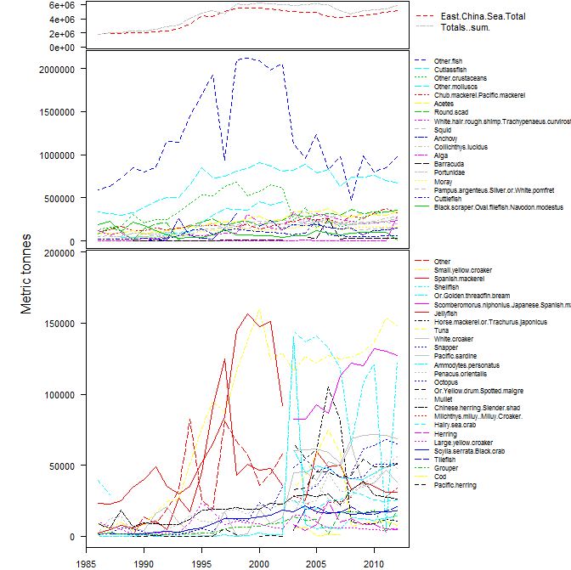

Slide 33
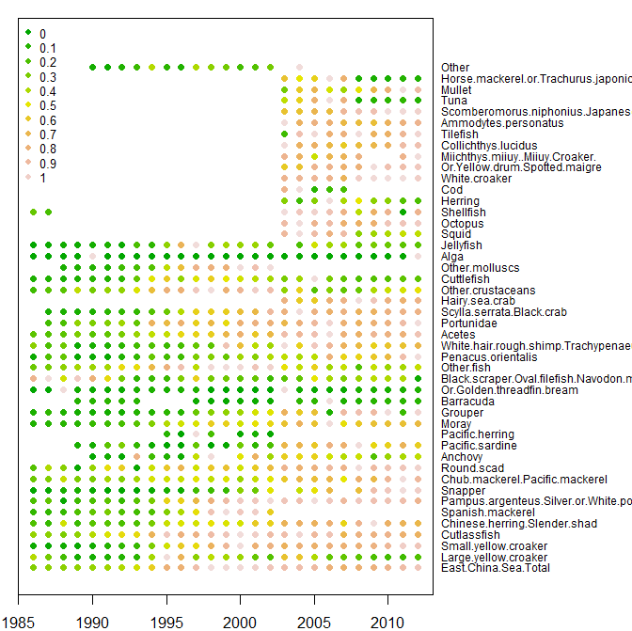

Slide 34
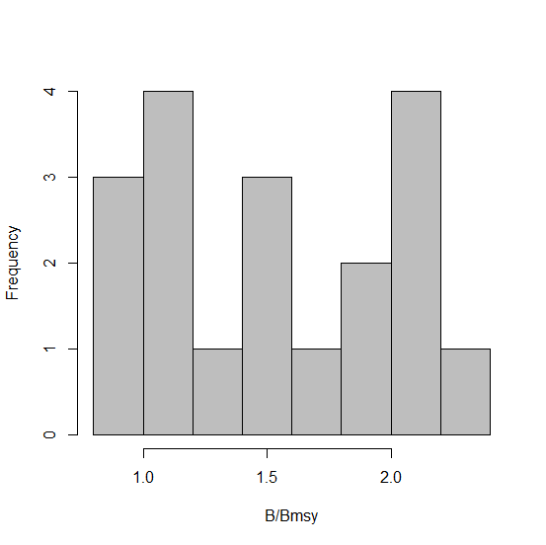

Slide 35
 | Mod1 | Mod2 | Mod3 | Mod4 | Mod5 | Mod6
Inverse age | -0.057 | -0.037 | 0.055 | 0.041 | 0.049 | 0.018
Scaled catch 4 years ago | -0.139 | -0.13 | -0.056 | -0.096 | -0.101 | -0.118
Scaled catch 3 years ago | -0.055 | -0.057 | 0.006 | -0.004 | -0.003 | -0.02
Scaled catch 2 years ago | 0.034 | 0.044 | 0.153 | 0.136 | 0.136 | 0.136
Scaled catch 1 years ago | 0.253 | 0.287 | 0.426 | 0.416 | 0.426 | 0.437
Scaled catch current | 0.255 | 0.137 | -0.474 | -0.372 | -0.393 | -0.475
Years to max catch | 0.011 | 0.011 | 0.007 | 0.008 | 0.007 | 0.005
Initial slope of catch | -0.039 | 0.021 | 0.128 | 0.108 | 0.106 | 0.171
maximum catch | 0 | 0 | 0 | 0 | 0 | 0
mean scaled catch | 0.978 | 0.763 | -0.473 | -0.263 | -0.357 | -0.24
Von Bert K | 0.378 | 0.818 | 1.292 | 0.984
Temperature | 0.002
Geographic distribution | 0 | 0 | 0
Max length | -0.003 | -0.003 | -0.003 | -0.003 | -0.003
Age at maturity | -0.025 | -0.003
Running harvest ratio | 0.705 | 0.794 | 1.231 | 1.165 | 1.184 | 1.167
Current year | -0.062 | -0.041 | 0.056 | 0.039 | 0.047 | 0.016
Cods | 0.242 | 0.297 | 0.331 | 0.39 | 0.379 | 0.1
Misc. coastal fish | 0.124 | 0.153 | -0.951 | -0.71 | -0.618 | -0.476
Misc. demersal fish | 1.015 | 0.932 | 0.815 | 0.796 | 0.755 | 0.671
Herrings sardines anchovies | -0.106 | -0.075 | -0.238 | -0.102 | 0.058 | 0.093
Tuna bonito billfish | 0.314 | 0.641 | 0.818 | 0.785 | 0.943 | 0.255
Misc pelagic fish | -0.003 | 0.395 | 0.288 | 0.437 | 0.492 | 0.402
Constant | 123.799 | 80.707 | -112.955 | -78.581 | -95.563 | -32.489

Slide 36
Regression interpretation (model 6)
↑ Catch[t-1]
↑status
↑ Catch[t]/max(Catch[1:(t-1)])
↑ status
Demersal fish
↑ status.

Slide 37
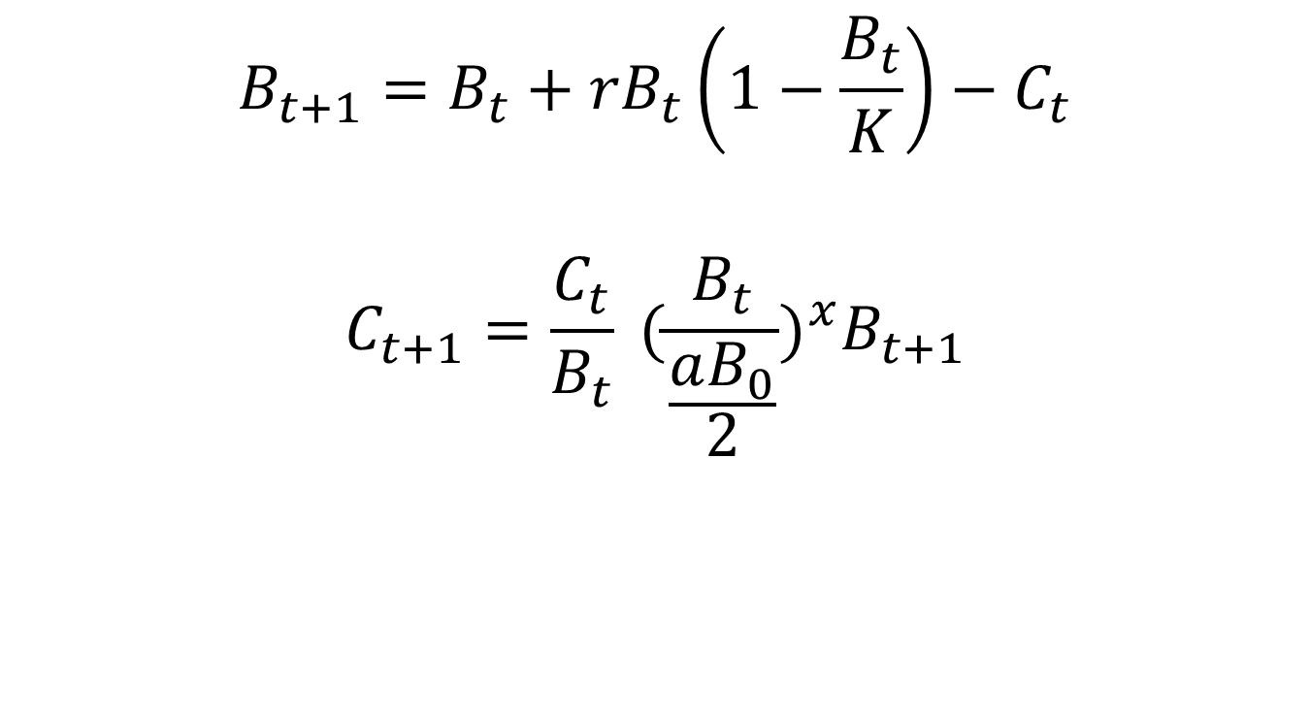
Simulate known populations
$$B_{t+1}=B_{t}+{rB}_{t}\left(1−\frac{B_{t}}{K}\right)−C_{t}$$
$$C_{t+1}=\frac{C_{t}}{B_{t}} {(\frac{B_{t}}{\frac{aB_{0}}{2}})}^{x}B_{t+1}$$
Notes:
The logical rebuttle to the reason the methods aren’t able to predict the statuses is that the RAM stocks don’t behave like the simulated population. However, the validity of the concept of MSY requires that these models are correct.

Slide 38
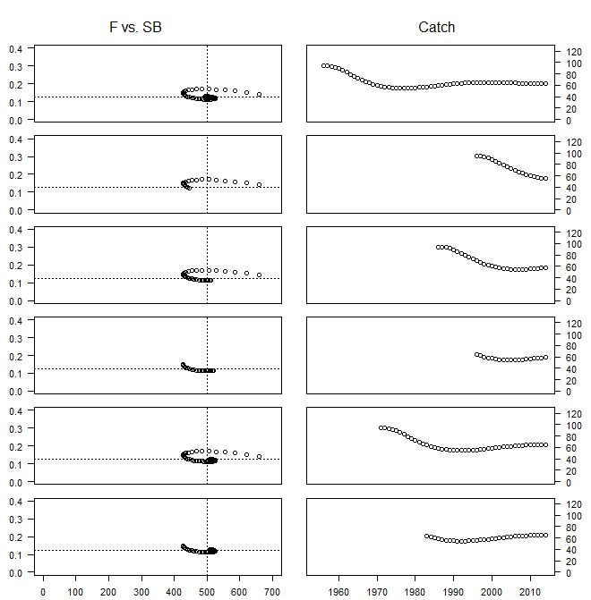
Estimated status | True status
1.37 | .98
1.23 | .89
1.29 | 1.02
1.75 | 1.03
1.41 | 1.01
2.22 | 1.01

Slide 39

Estimated status | True status
1.01 | .98
.91 | .89
.95 | 1.02
1.29 | 1.03
1.04 | 1.01
1.63 | 1.01

Slide 40
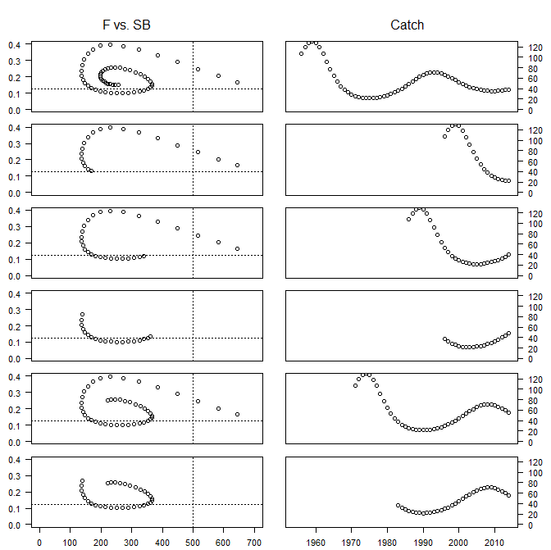
Estimated status | True status
.98 | .51
.83 | .34
.99 | .68
2.45 | .72
1.15 | .44
1.83 | .44

Slide 41

Estimated status | True status
.73 | .51
.61 | .34
.73 | .68
1.81 | .72
.85 | .44
1.35 | .44

Slide 42
Challenges of catch-based methods
Technical efficiency
Trophic interactions
Environment – MSwhy are we still using this??? (c)
RAMiness
Time series similarity between the fisheries

